Slide 1
Home automation - phase 2

Slide 2

Contents
Task given
our solution for the task
Conclusion

Slide 3

Tasks given:
Automatic switching on and off of the motor in our house
monitor the power used by house over a period of 30 days and display it dynamically
Monitor the power used the devices in a room in which our home automation kit is installed

Slide 4
Task 1 solution:
Water level monitor
components used
Ultrasonic sensor measures the lowest and highest water levels of the water tank.If the level of water is high,the distance measured by ultrasonic sensor will be low and when the water level is low,the distance measured by ultrasonic sensor will be high.
Thus, when sensor reading is high,the motor turns on and when reading is low motor turns off.
Ultrasonic sensor
NodeMCU
Motor

Slide 5
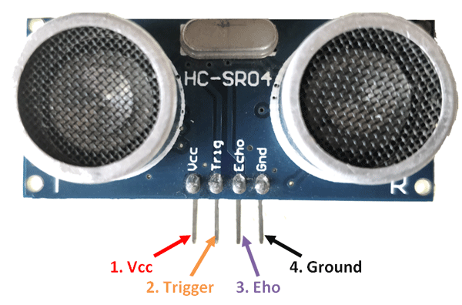
HC SR04-ULTRASONIC SENSOR
PURPOSE IN OUR PROJECT
Operating voltage: +5V
Theoretical Measuring Distance: 2cm to 450cm
Practical Measuring Distance: 2cm to 80cm
Accuracy: 3mm
Measuring angle covered: <15°
Operating Current: <15mA
Operating Frequency: 40Hz
To detect the water level

Slide 6
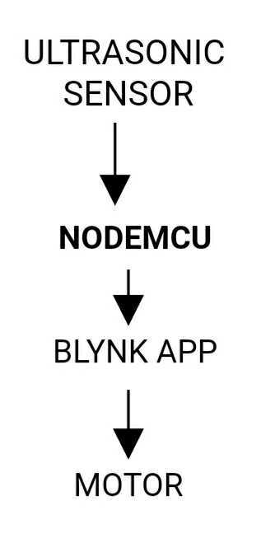

Slide 7

Task 2 and 3 solution:
Measuring the power consumption using SCT-013 Current Sensor and ZMPT101B AC Single Phase Voltage Sensor.

Slide 8
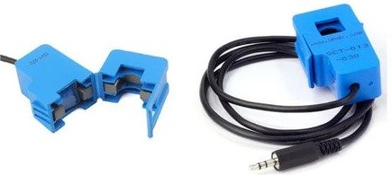
SCT-013 Current Sensor
SPECIFICATIONS
WORKING PRINCIPLE
Input Current (RMS): 0∼100A
Turn ratio: 100A:0.05A
Output Current: 0-50mA
A current carrying conductor generates uniform magnetic field around it.a current transformer has a primary winding, a magnetic core, and a secondary winding.
The sensor had to be clipped around the phase or neutral wire of the main connection and it works on the transformer principle

Slide 9
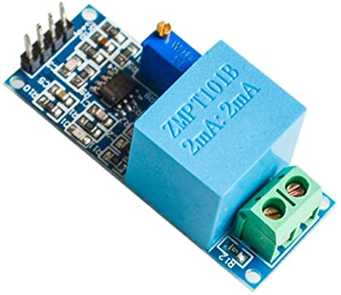
ZMPT101B AC Single Phase Voltage Sensor
SPECIFICATIONS 1.Voltage up to 250 volts can be measured
2. Lightweight with on-board micro-precision voltage transformer
3. High precision on-board op-amp circuit
4. Operating temperature : 40ºC ~ + 70ºC
5. Supply voltage 5 volts to 30 volts
DESCRIPTION
The ZMPT101B AC Single Phase voltage sensor module is based on a high precision ZMPT101B voltage Transformer used to measure the accurate AC voltage with a voltage transformer.

Slide 10
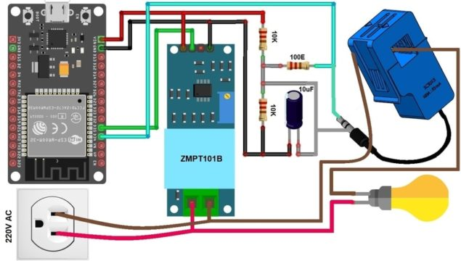

Slide 11

Blynk App
The readings of the sensors in terms of current,voltage and power can be viewed through the blynk application.

Slide 12
Libraries required:
EmonLib Library
Blynk Library

Slide 13
Thanks!

